Slide 1



Ethics in Cyber security
and other legal jargon

Slide 2
This workshop is non-technical
Feel free to chime in whenever if you have any questions or additional comments

Slide 4
White hat Hacking
Ethical / good intensions
Have explicit permission
Use gained information to improve security of said system
Is the ONLY Legal form of ‘hacking’

Slide 5
Permissions
Permissions must be exhaustive
Can only hack to the extent of permissions given
Must come from the correct person, ensure person giving permission can legally do so.
MISC Constitution clause:
24c , 24d

Slide 6
Careers?

Slide 7
Pen-tester
Security engineer
Systems Administrator
Network engineer
Security analyst etc.

Slide 8

Black hat Hacking
Hack into a system you are not allowed to
Use vulnerabilities found for personal gain
Nefarious/ unethical intent
VERY ILLEGAL , it is a criminal offence in most countries.

Slide 9
Careers?

Slide 10
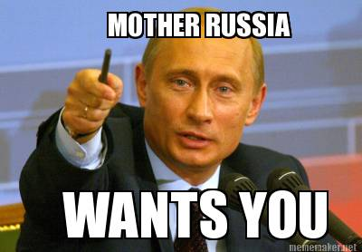

Sell all that info for $$$
or
Get caught and go to jail
or
But seriously though, Intelligence agencies do recruit people to do black hat stuff

Slide 11

Grey hat Hacking
Not ethically bad intentions
Hack into something you don’t have explicit permission to
Don’t use the information gained for harm
Is illegal on paper
e.g. bug bounties (somewhat)

Slide 12
In real life
Systems are not 100% secure
Vulnerabilities take time to patch if they are every patched
Hacktivism
Good / Bad becomes subjective
Politics comes into play

Slide 13
In real life
Few examples in real life:
Kevin Mitnick – from a kid hacking for fun to a fugitive to a CEO of a security firm
Zuckerburg Facebook page hack [1]

Slide 14
Code of Conduct
Always make sure you have the correct permissions
Members are responsible for their own actions, the club will not take responsibility on behalf of the members
If you find a bug, report to the owner of the system before making it public
Never try a DoS (denial of service) attack, even on your own machines or systems

Slide 15
Next Semester
CySCA 2019
CySCA prep workshops
AGM (sometime in September)
CTF bot / Hackerman discord bot
In-house CTF (maybe)
More pizza

